Slide 1
Lecture 30

Slide 2
Question 123.11.1
You open your freezer (or a door in January in Rexburg), does energy flow out, or does cold flow in?
Cold in
Energy out

Slide 3
Question 123.11.2
You use Joule’s paddle apparatus to raise the temperature of a fluid. Is any heat involved?
Yes
No
Maybe

Slide 4
Internal Energy
Internal Energy, U, is the energy associated with the microscopic components of the system
Includes kinetic and potential energy associated with the random translational, rotational and vibrational motion of the atoms or molecules
Also includes any potential energy bonding the particles together
internal energy is all the energy of a system that is associated with its microscopic components -- atoms and molecules -- when viewed form a reference frame at rest with respect to the center of mass of the system.

Slide 5


Review Center of Mass
Recall that
Where
For a group of molecules

Slide 6
Energy Transfer
When two objects of different temperatures are placed in thermal contact, the temperature of the warmer decreases and the temperature of the cooler increases
The energy exchange ceases when the objects reach thermal equilibrium
The concept of energy was broadened from just mechanical to include internal
Made Conservation of Energy a universal law of nature

Slide 7
Heat Compared to Internal Energy
Important to distinguish between them
They are not interchangeable
They mean very different things when used in physics

Slide 8
Heat
Heat is the transfer of energy between a system and its environment because of a temperature difference between them
The symbol Q is used to represent the amount of energy transferred by heat between a system and its environment

Slide 9
Units of Heat
Calorie
An historical unit, before the connection between thermodynamics and mechanics was recognized
A calorie is the amount of energy necessary to raise the temperature of 1 g of water from 14.5° C to 15.5° C .
A Calorie (food calorie) is 1000 cal

Slide 10
Units of Heat, cont.
US Customary Unit – BTU
BTU stands for British Thermal Unit
A BTU is the amount of energy necessary to raise the temperature of 1 lb of water from 63° F to 64° F
1 cal = 4.186 J
This is called the Mechanical Equivalent of Heat

Slide 11
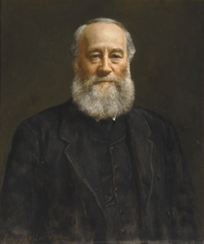
James Prescott Joule
1818 – 1889
British physicist
Conservation of Energy
Relationship between heat and other forms of energy transfer

Slide 12
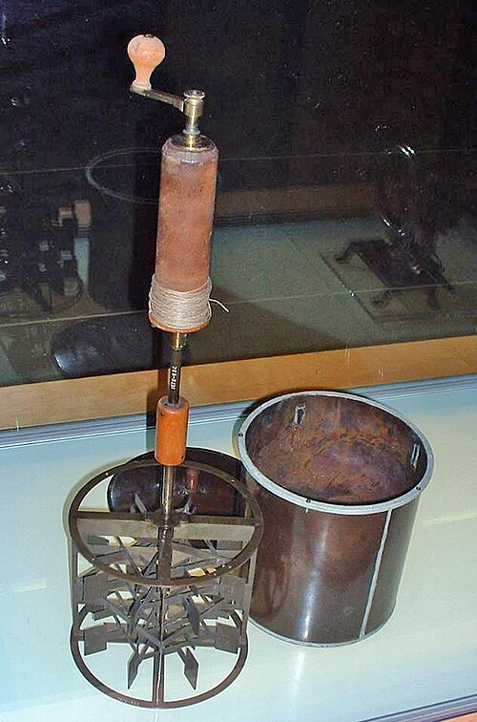
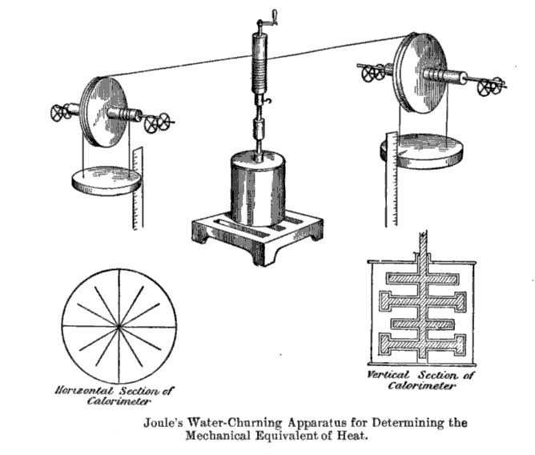

Slide 13



Slide 14
ΔT
Q

Slide 16
Specific Heat
Every substance requires a unique amount of energy per unit mass to change the temperature of that substance by 1° C
The specific heat, c, of a substance is a measure of this amount

Slide 17
Specific Heat
Every substance requires a unique amount of energy per unit mass to change the temperature of that substance by 1° C
The specific heat, c, of a substance is a measure of this amount

Slide 19
Units of Specific Heat
SI units
J / kg °C
Historical units
cal / g °C

Slide 20
Heat and Specific Heat
Q = m c ΔT
ΔT is always the final temperature minus the initial temperature
When the temperature increases, ΔT and ΔQ are considered to be positive and energy flows into the system
When the temperature decreases, ΔT and ΔQ are considered to be negative and energy flows out of the system

Slide 21

A Consequence of Different Specific Heats
Water has a high specific heat compared to land
On a hot day, the air above the land warms faster
The warmer air flows upward and cooler air moves toward the beach

Slide 22
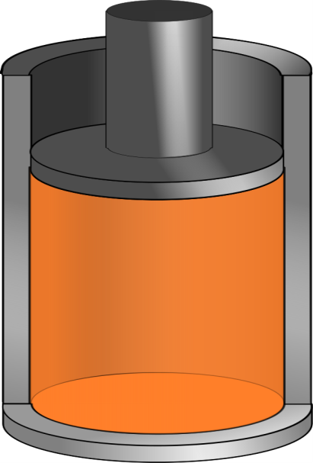
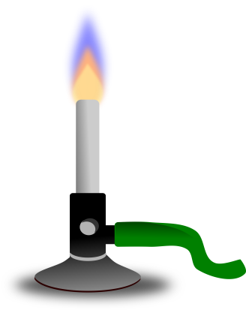
Q negative
Q positive

Slide 23
Question 123.12.2
You add energy to an object by heat transfer. At some point, the temperature of the object stops rising. What is happening?
The system is leaking thermal energy
The system has as much heat as it can take
The object is experiencing a phase change
Can’t tell

Slide 25
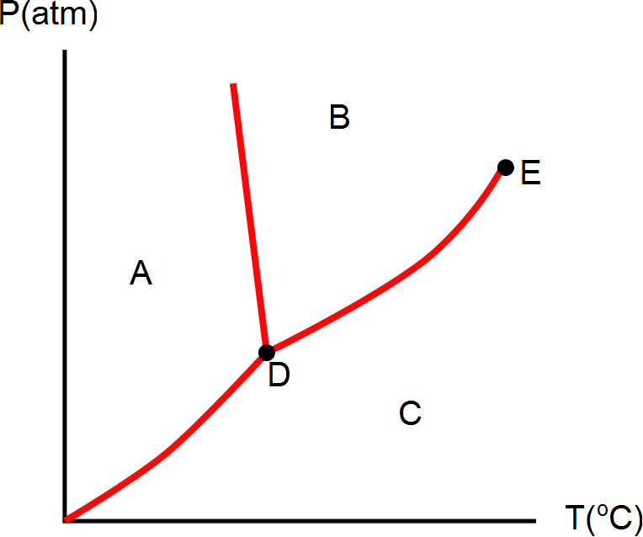
Question 123.8.11
What phase would this substance have if is were in the state represented by letter C?
Solid
Liquid
Gas
Plasma

Slide 28
Question 123.8.11
What phase would this substance have if is were in the state represented by letter A?
Solid
Liquid
Gas
Plasma

Slide 29
Question 123.8.11
What phase would this substance have if is were in the state represented by letter B?
Solid
Liquid
Gas
Plasma

Slide 30
Question 123.8.12
What is point D?
Sublimation point
Boiling point
Triple point
Double point
Critical point

Slide 31
Question 123.8.12
What is point E?
Sublimation point
Boiling point
Triple point
Double point
Critical point

Slide 32
Question 123.8.12
What do we call moving from region A to region B?
Boiling
Freezing
Melting
Condensing
Sublimation

Slide 33
Question 123.8.12
What do we call moving from region A to region C?
Boiling
Frezzing
Melting
Condensing
Sublimation

Slide 34
Question 123.8.12
What do we call moving from region B to region C?
Boiling
Frezzing
Melting
Condensing
Sublimation

Slide 35
Question 123.8.12
What do we call moving from region C to region B?
Boiling
Frezzing
Melting
Condensing
Sublimation

Slide 36
Question 123.8.12
What do we call moving from region B to region A?
Boiling
Frezzing
Melting
Condensing
Sublimation

Slide 37
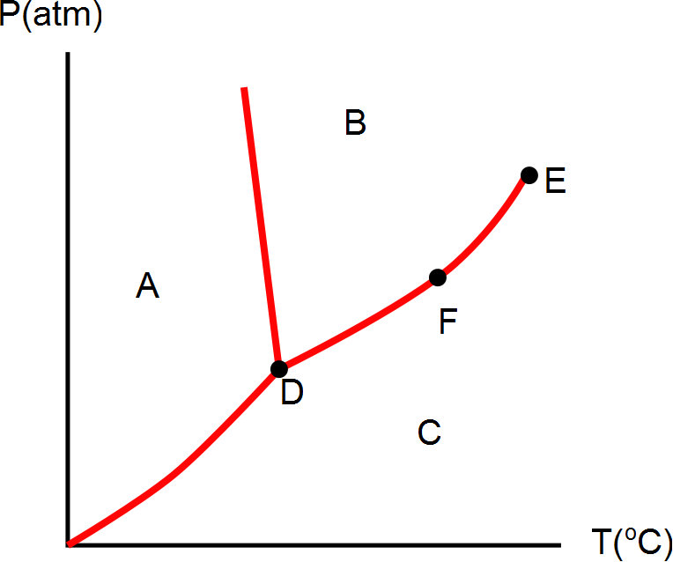
Question 123.8.12
What phase is the material at if it is in the state represented by letter D?
Solid
Liquid
Gas
Plasma
Can’t tell

Slide 38
Question 123.8.12
What can we say about the state represented by point F?
Solid
Liquid
Gas
Plasma
It is a phase equilibrium

Slide 39
[Figure] [More Complete Phase Diagram for Water (Public Domain Image courtesy Karlhahn)]

Slide 40
Question 123.12.1.1
I have a sample of a substance with a heat capacity of 100J/K. How much heat can this sample hold if it is at 2000K?
2000000J
20J
0.5J
None at all

Slide 41
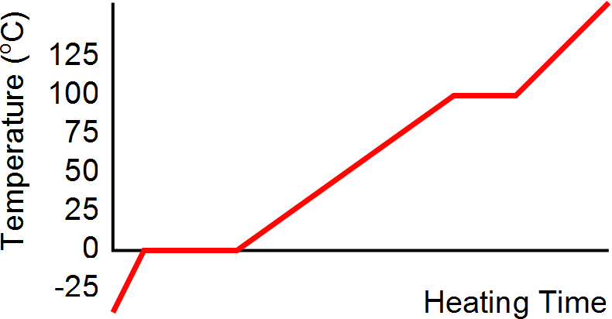
Heating Ice
Gaseous steam
Boiling water
Liquid water
Melting ice
Solid ice

Slide 42
Graph of Ice to Steam
T(ºC)
150
120
90
60
30
0
-30
Steam
Water and Steam
Water
Ice and water
0 500 1000 1500 2000 2500 3000
Ice
Energy added (J)

Slide 43
Calorimeter
One technique for determining the specific heat of a substance
A calorimeter is a vessel that is a good insulator which allows a thermal equilibrium to be achieved between substances without any energy loss to the environment

Slide 44
Calorimetry
Analysis performed using a calorimeter
Conservation of energy applies to the isolated system
The energy that leaves the warmer substance equals the energy that enters the water
Q_{cold} = -Q_{hot}
Negative sign keeps consistency in the sign convention of ΔT

Slide 45
Calorimeter
Sample at known temperature T_{x}
Water temperature rises
Water at known temperature T_{w}
Insulated container

Slide 46
Calorimetry
Object #1
Object #2

Slide 47
Calorimetry
Object #1
Object #2

Slide 48
Mixture Example
200 cm³ of hot water at 95ºC is poured into a 150 g glass cup initially at 25ºC. What is the final temperature of the mixture when equilibrium is reached, assuming no heat flows to the surroundings.

Slide 49
Mixture Example
200 g
What is the mass of 200 cm³ of water?

Slide 50
END

Slide 52
Q negative
Q positive

Slide 53
Question 123.11.3
You increase the temperature of a gas in a piston. Is there heat involved?
Yes
No
Maybe

Slide 54
Question 123.11.6
Which graph represents an isothermal process?
A B C

Slide 55
300K
100K

Slide 56
300K
100K

Slide 57
Warmer
Cooler

Slide 58
Question 123.11.4
You put a gas in a piston through a process that changes the temperature. Can Q=0?
Yes, if it is the right process
No
Maybe

Slide 59
Question 123.11.5
Which quantity is independent of path
Q
ΔE_{int}
W
Can’t tell

Slide 60
Phase Changes
A phase change occurs when the physical characteristics of the substance change from one form to another
Common phases changes are
Solid to liquid – melting
Liquid to gas – boiling
Phases changes involve a change in the internal energy, but no change in temperature

Slide 61
Latent Heat
During a phase change, the amount of heat is given as
Q = ±m L
L is the latent heat of the substance
Latent means hidden
L depends on the substance and the nature of the phase change
Choose a positive sign if you are adding energy to the system and a negative sign if energy is being removed from the system

Slide 62
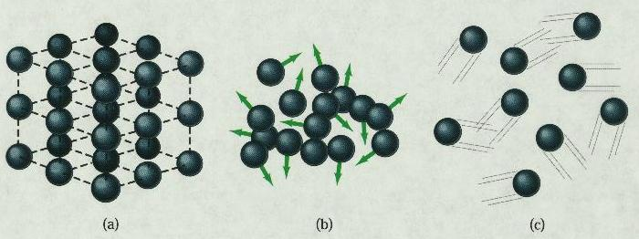
Phase Changes Latent Heat
Solid
Liquid
Gas
During a phase change, the internal energy changes but the temperature does not change.
Work is done against the attractive molecular forces to separate them.

Slide 63
Latent Heat, cont.
SI units of latent heat are J / kg
Latent heat of fusion, L_{f}, is used for melting or freezing
Latent heat of vaporization, L_{v}, is used for boiling or condensing
Table 11.2 gives the latent heats for various substances

Slide 64
Sublimation
Some substances will go directly from solid to gaseous phase
Without passing through the liquid phase
This process is called sublimation
There will be a latent heat of sublimation associated with this phase change

Slide 65
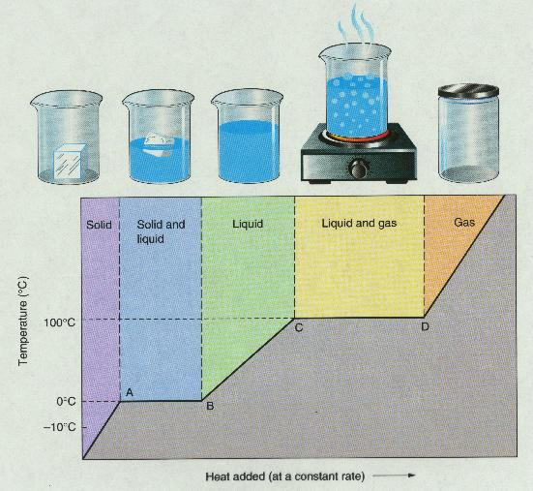
T vs. Q Graphs

Slide 66
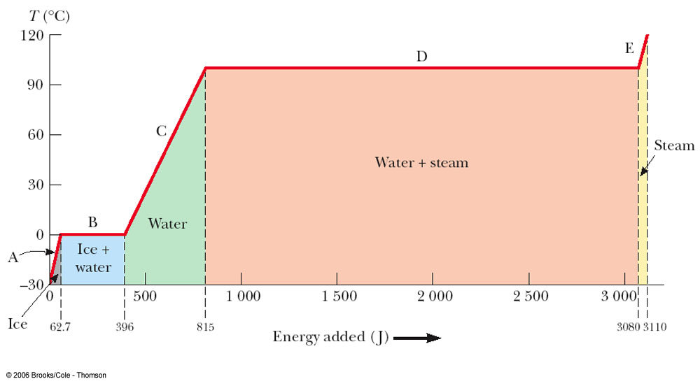
Graph of Ice to Steam

Slide 67
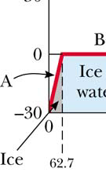
Warming Ice
Start with one gram of ice at –30.0º C
During A, the temperature of the ice changes from –30.0º C to 0º C
Use Q = m c ΔT
Will add 62.7 J of energy

Slide 68
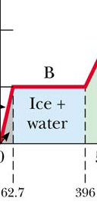
Melting Ice
Once at 0º C, the phase change (melting) starts
The temperature stays the same although energy is still being added
Use Q = m L_{f}
Needs 333 J of energy

Slide 69
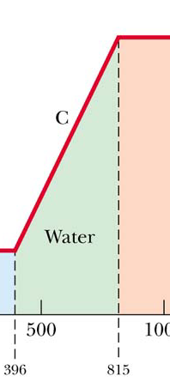
Warming Water
Between 0º C and 100º C, the material is liquid and no phase changes take place
Energy added increases the temperature
Use Q = m c ΔT
419 J of energy are added

Slide 70
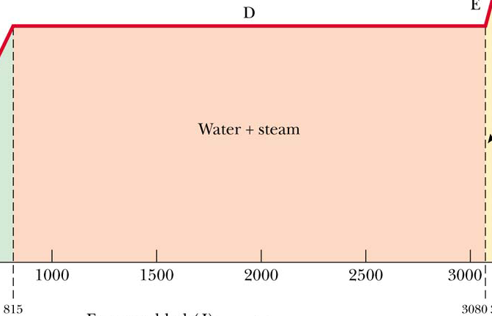
Boiling Water
At 100º C, a phase change occurs (boiling)
Temperature does not change
Use Q = m Lv
2 260 J of energy are needed

Slide 71
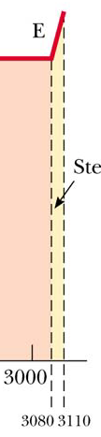
Heating Steam
After all the water is converted to steam, the steam will heat up
No phase change occurs
The added energy goes to increasing the temperature
Use Q = m c ΔT
To raise the temperature of the steam to 120°, 40.2 J of energy are needed

Slide 72
Problem Solving Strategies
Make a table
A column for each quantity
A row for each phase and/or phase change
Use a final column for the combination of quantities
Use consistent units

Slide 73
Problem Solving Strategies, cont
Apply Conservation of Energy
Transfers in energy are given as Q=mcΔT for processes with no phase changes
Use Q = m L_{f} or Q = m L_{v} if there is a phase change
In Q_{cold} = - Q_{hot} be careful of sign
ΔT is T_{f} – T_{i}
Solve for the unknown

Slide 74
20.4 Work and Heat in Thermodynamic Processes

Slide 75

Work in a Gas Cylinder
The gas is contained in a cylinder with a moveable piston
The gas occupies a volume V and exerts pressure P on the walls of the cylinder and on the piston

Slide 76
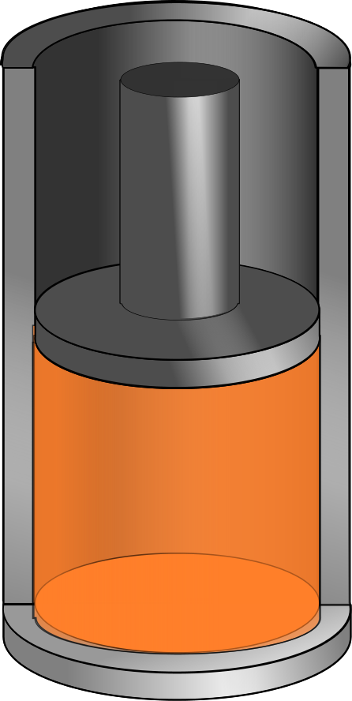
Work in a Gas Cylinder, cont.
A force is applied to slowly compress the gas
The compression is slow enough for all the system to remain essentially in thermal equilibrium
W = - P ΔV
This is the work done on the gas
Δy

Slide 77
More about Work on a Gas Cylinder
When the gas is compressed
ΔV is negative
The work done on the gas is positive
When the gas is allowed to expand
ΔV is positive
The work done on the gas is negative
When the volume remains constant
No work is done on the gas

Slide 78
Notes about the Work Equation
The pressure remains constant during the expansion or compression
This is called an isobaric process
If the pressure changes, the average pressure may be used to estimate the work done

Slide 79
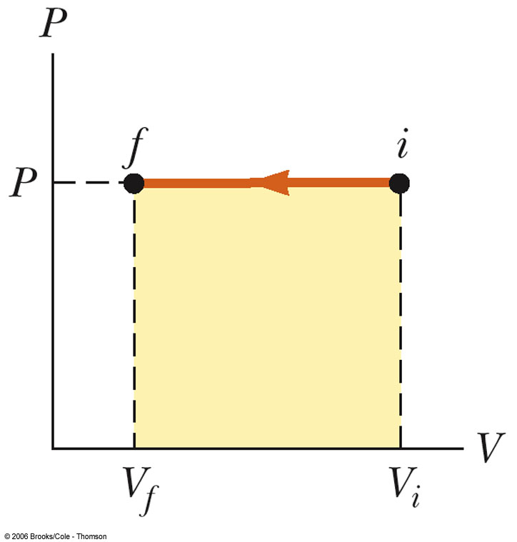
PV Diagrams
Used when the pressure and volume are known at each step of the process
The work done on a gas that takes it from some initial state to some final state is the negative of the area under the curve on the PV diagram
This is true whether or not the pressure stays constant

Slide 80
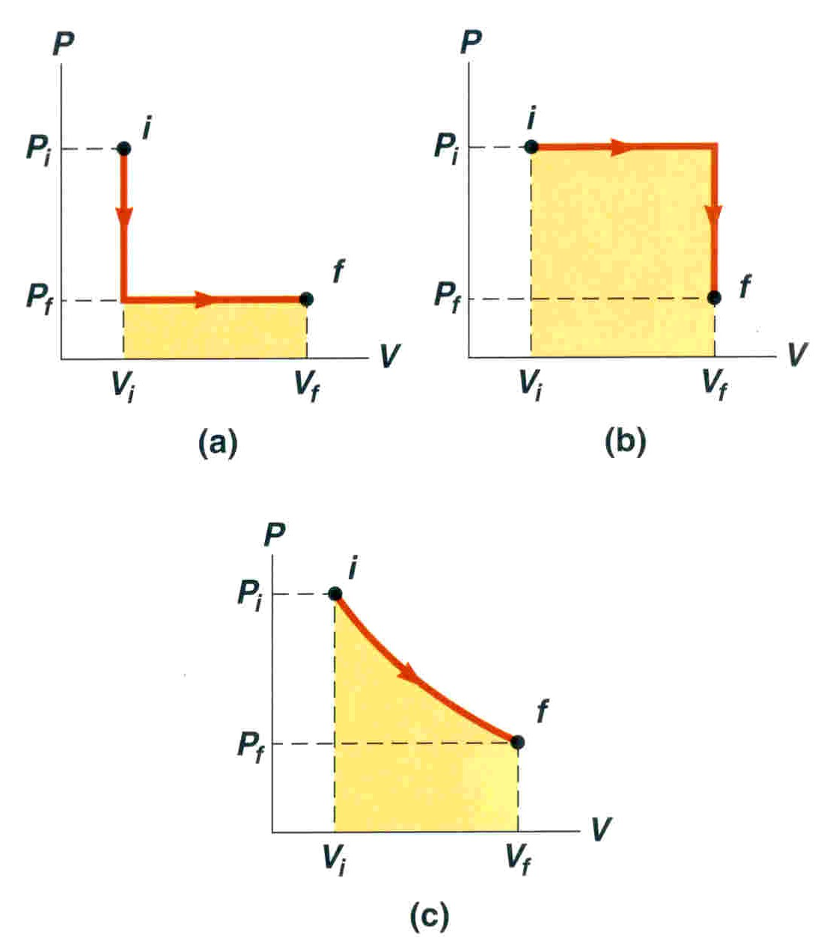
PV Diagrams, cont.
The curve on the diagram is called the path taken between the initial and final states
The work done depends on the particular path
Same initial and final states, but different amounts of work are done

Slide 81
Summary
Specific Heat
Latent Heat

Slide 82
Summary
Work in Thermodynamic Processes
PV diagrams
Problems to try 12-19
W = - P ΔV

Slide 83
End

Slide 84
Molecular Model of an Ideal Gas

Slide 86
Question 123.14.1.5
A car is driving down I-20 at 70mph (the new speed limit). Does the center of mass of the car have the same kinetic energy as a piston in the engine?
Yes
No
Maybe
Wait, the speed limit changed?

Slide 87
Question 123.14.1
We have two gases, each with the same values of n, V and T. One gas is Hydrogen, the other is Nitrogen. For which gas is the rms speed larger?
Hydrogen
Nitrogen

Slide 88
v_{system}
v_{molecule}
V
P
n
T

Slide 90
Question 123.14.2
If the temperature increases, the peak of the Maxwell-Boltzmann speed distribution
Increases to a higher velocity
Decreases to a lower velocity
Stays the same
Can’t tell

Slide 91
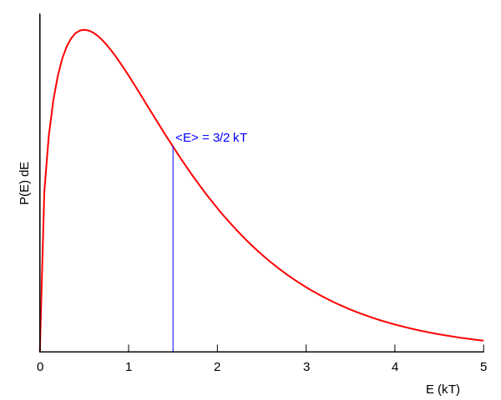
Boltzmann Distribution

Slide 92
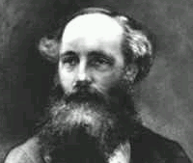
Found an expression for the Molecular Speed Distribution
James Clerk Maxwell (1831-1879)

Slide 93
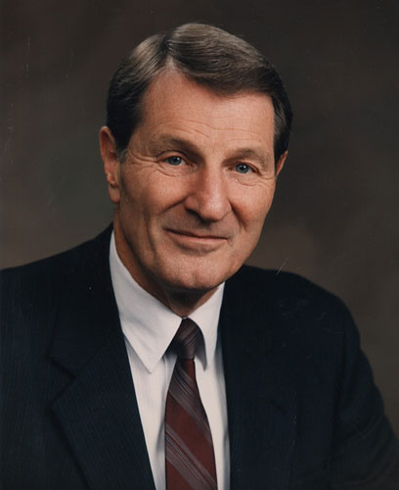
Not the same guy
Neal A. Maxwell
(1926-2004)

Slide 94
N - total number of molecules

Slide 95
Question 123.14.2
If the temperature increases, the peak of the Maxwell-Boltzmann speed distribution
Increases to a higher velocity
Decreases to a lower velocity
Stays the same
Can’t tell

Slide 96
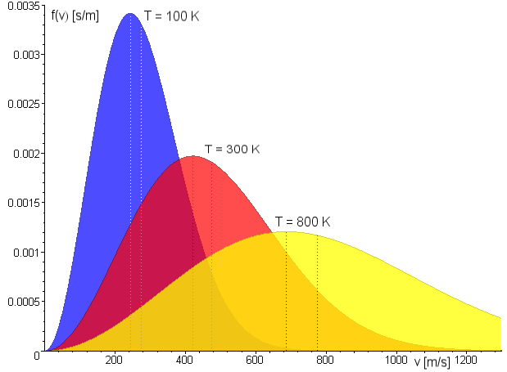
Maxwell Distribution
A system of gas at a given temperature will exhibit a variety of speeds
Three speeds are of interest:
Most probable
Average
rms
Image in the Public Domain couracy Fred Stober

Slide 97
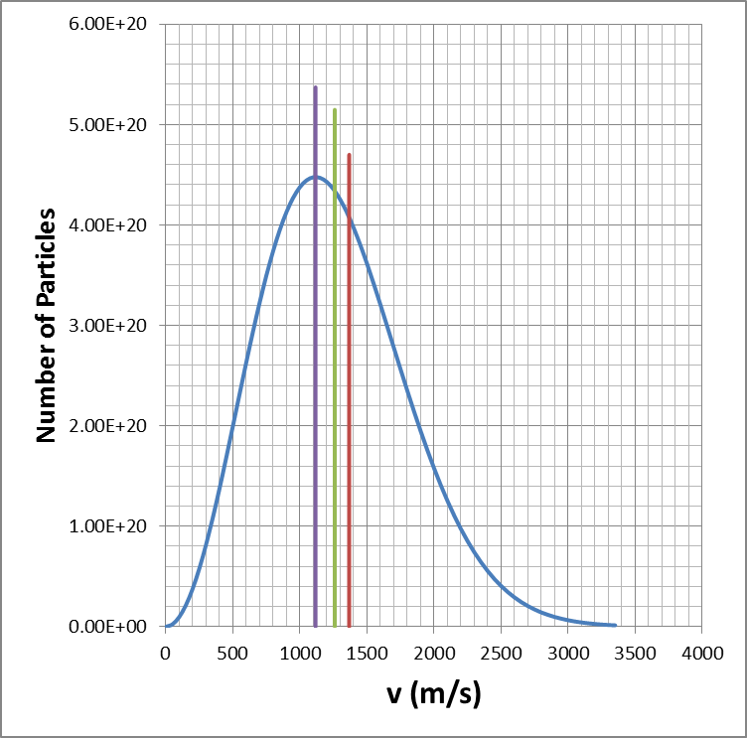
Molecular Speeds

Slide 98
Question 123.14.4
Two gases have the same number of molecules, the same volume, pressure, and temperature. Gas A has molecules that are twice the size of gas B. The mean path of A is
¼ the mean free path of B
½ the mean free path of B
Twice the mean free path of B
4 times the mean free path of B

Slide 99
Mean Free Path
The average distance between collisions. Depends on:
diameter of the molecules
density of gas
Random-walk process

Slide 100
Equivalent Collision
Collision
Equivalent Collision
d
d
d
d

Slide 101
L
2d

Slide 102
Mean Free Path
Collision Frequency
Random-walk process

Slide 103
Mean Free Path
For air molecules at room temperature:
(Molecule separation distance is 3.4x10⁻⁹ m.)

Slide 104
Partial Summary
Mean Free Path
Problems to try 21.45, 21.61
Extra Credit: Write up why the square root of 2 was needed

Slide 105
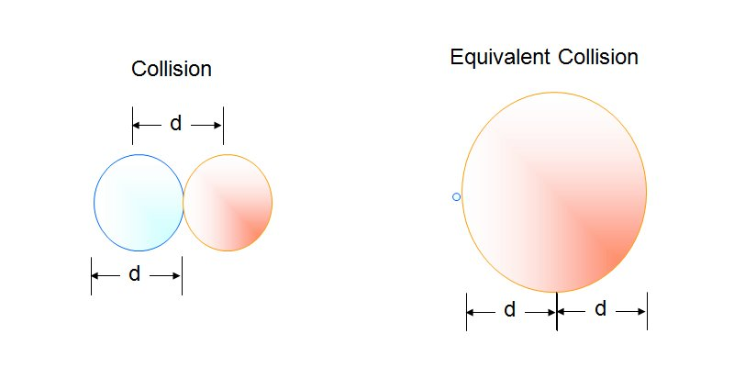

Slide 106
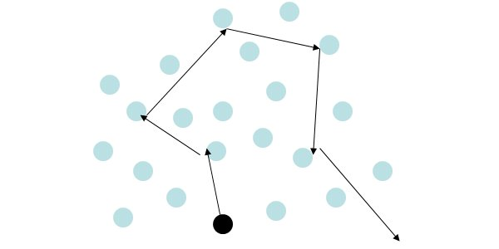

Slide 107
Assumptions
The number of molecules in the gas is large and the average separation between them is large compared to their dimensions
The molecules obey Newton’s laws of motion, but as a whole they move randomly

Slide 108
Assumptions, cont.
The molecules interact only by short-range forces during elastic collisions
The molecules make elastic collisions with the walls
The gas under consideration is a pure substance, all the molecules are identical

Slide 109
Question 123.14.5
A ball bounces off a wall. If the initial velocity of the ball is v_{x} and the final velocity of the ball is –v_{x}, what is the change in momentum of the ball?
mv_{x}
0
-mv_{x}
2mv_{x}
v_{x}
-v_{x}

Slide 110
Particle in a Box
d
v
d
v_{x}

Slide 111
Momentum of the Collision
v_{x}
-v_{x}

Slide 112
Question 123.14.5
A ball bounces off a wall. If the initial velocity of the ball is v_{x} and the final velocity of the ball is –v_{x}, what is the change in momentum of the ball?
mv_{x}
0
-mv_{x}
2mv_{x}
v_{x}
-v_{x}

Slide 113
Average Force and Impulse
F
t
F
F
F
t
t
F
t

Slide 114
Question 123.14.7
What is the name of this quantity?
Kale-Gordon factor
Boltzmann's factor
The average value of x
The standard deviation of x

Slide 115
Question 123.14.8
We learned a name for what is that name?
b)
c)
d) Craig

Slide 116
Some rms Speeds

